Slide 1
Customer Demographics and Purchasing Patterns Analysis An In-depth Analysis of Customer Behavior and Sales Trends
By
Ayon Kumar Das

Slide 2
Objective: To analyze customer demographics to understand their purchasing patterns and provide strategic recommendations for targeted marketing.
Importance: Understanding customer behavior is crucial for optimizing marketing efforts and improving customer engagement.

Slide 3
Data Sources
Datasets Used:
Customers: dbo.proj_customers
Sales: dbo.proj_sales
Products: dbo.proj_products

Slide 4
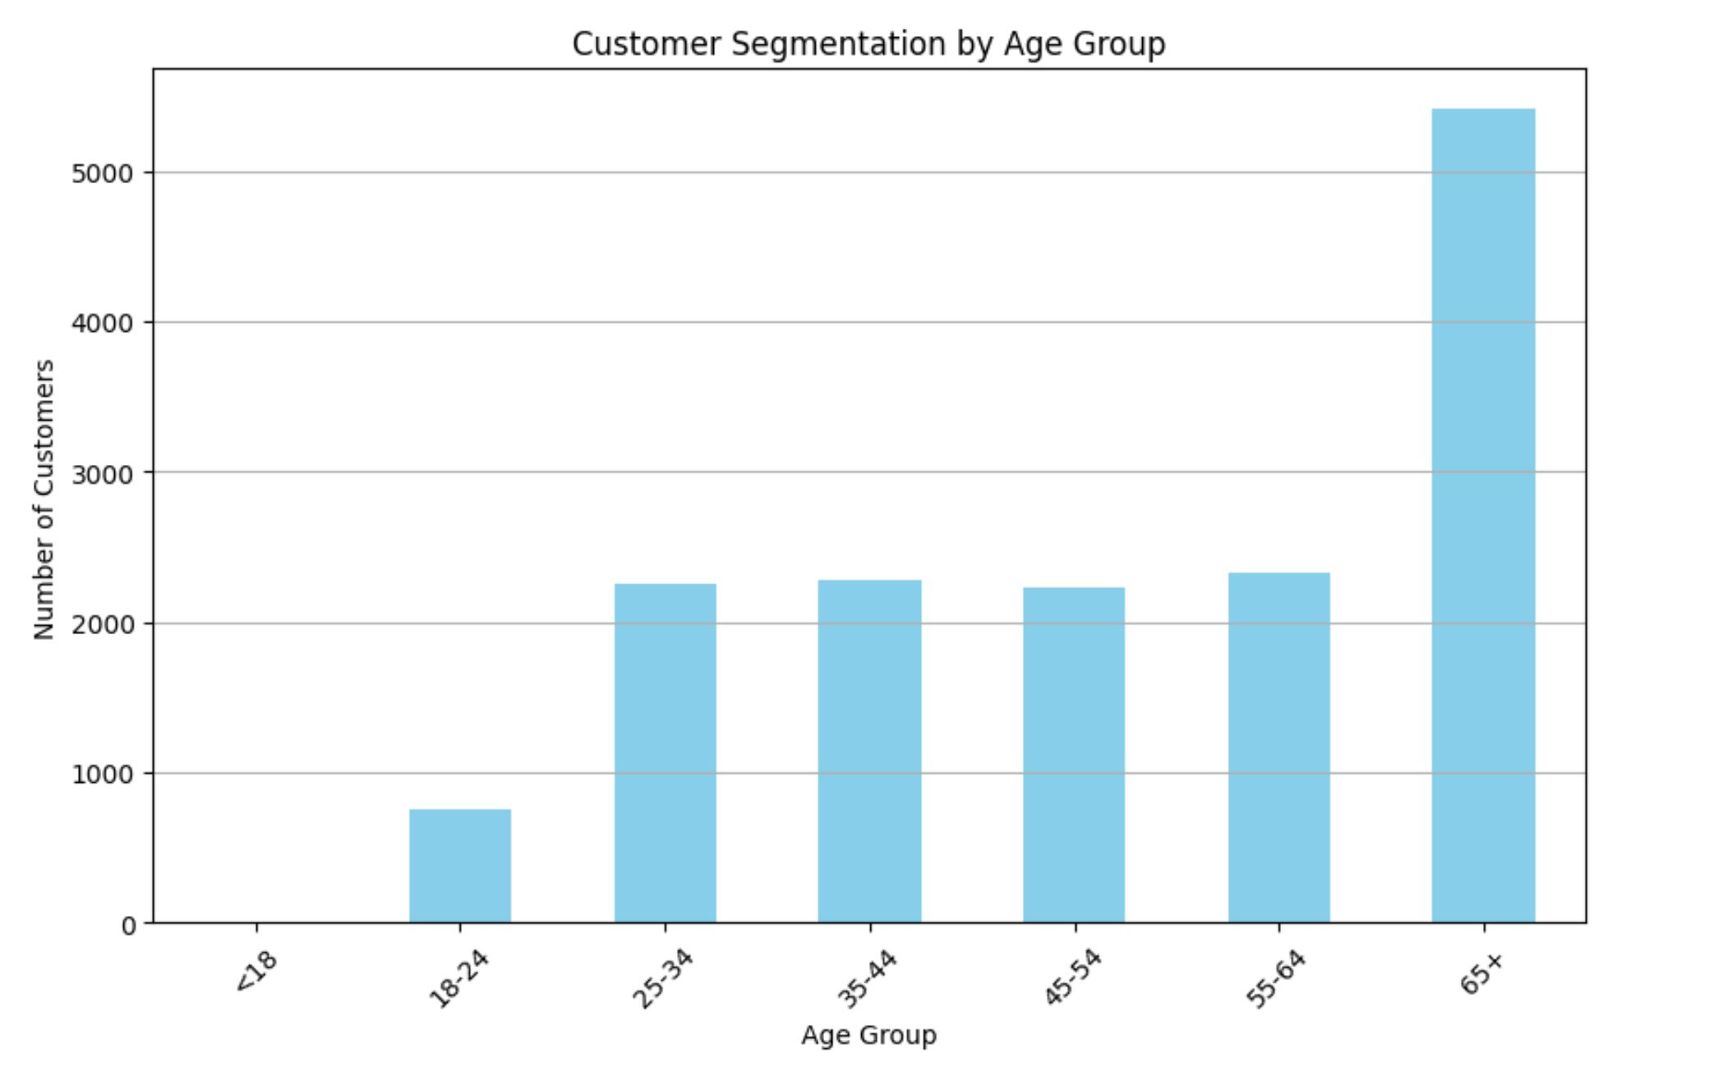
Customer Segmentation Segmented customers based on age groups

Slide 5
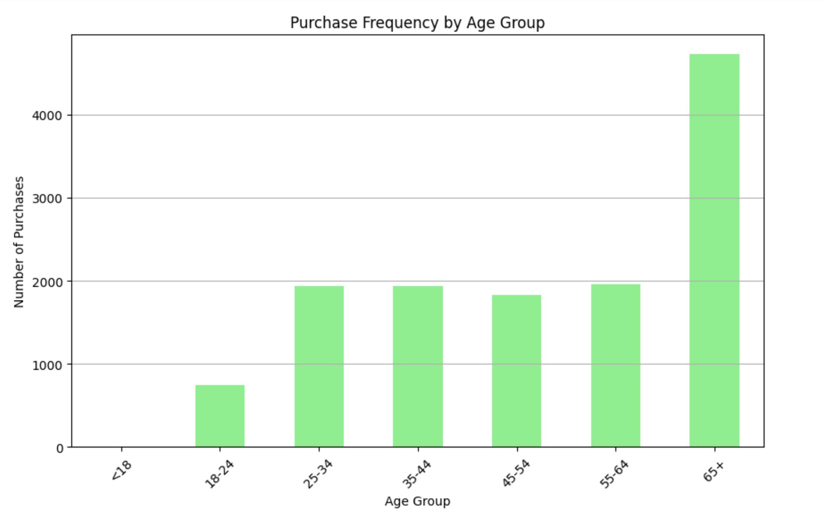
Purchasing Patterns Analysis - Purchase Frequency Analysis of how often different age groups make purchases

Slide 6
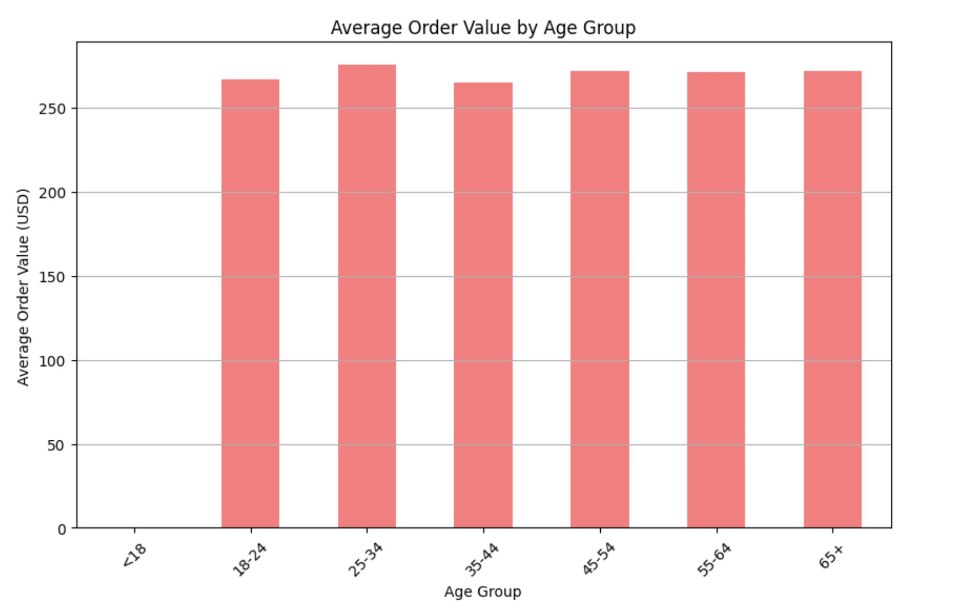
Purchasing Patterns Analysis - Average Order Value Average spending of different age groups

Slide 7
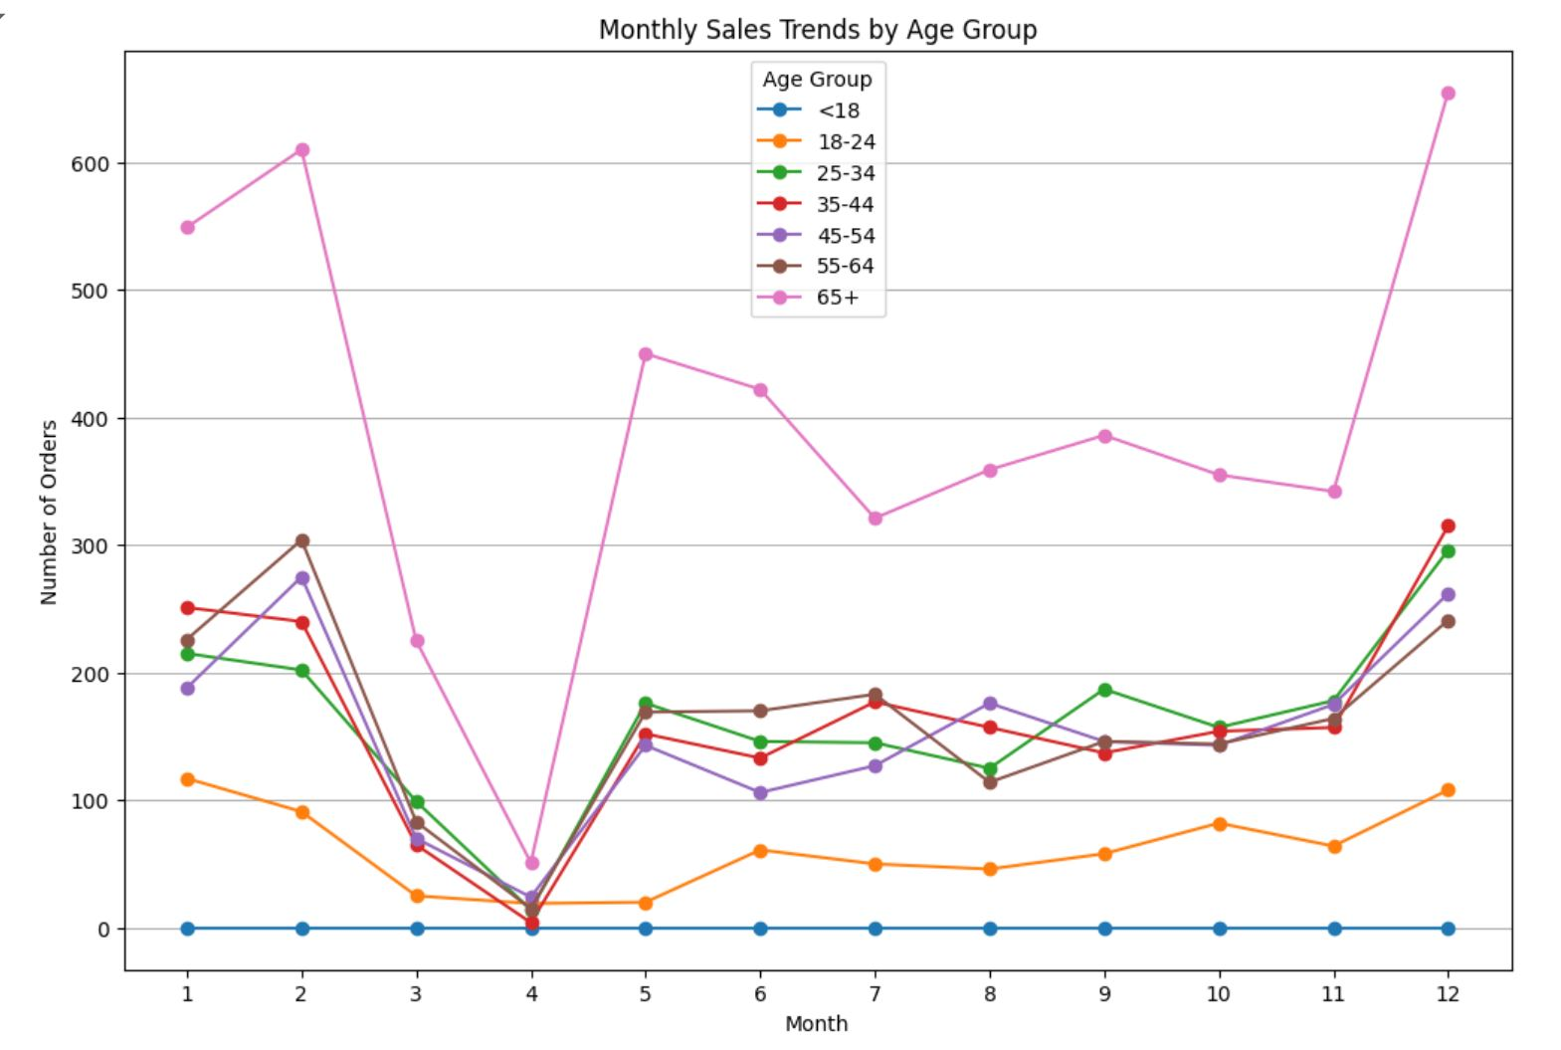
Seasonal Trends Examination of seasonal trends in purchasing behavior

Slide 8
Slide 9: Insights
Customer Segmentation: The majority of customers are in the 65+ age group.
Purchase Frequency: Higher purchase frequency in the 65+ age group.
Average Order Value: Relatively consistent across age groups.
Seasonal Trends: Identified peak purchasing periods during holiday months.

Slide 9
Recommendations
Marketing Strategies:
Focus on the 65+ age group with tailored marketing campaigns.
Increase stock of top-selling products during peak months.
Implement personalized marketing strategies for different age groups

Slide 10
What ELSE?

Slide 11


